Slide 1

Spread of Infectious Diseases using Graphs
Matthew A. Krieger
Computer Science Student
Central Connecticut State University

Slide 2
Simulation of the Spread of Infectious Diseases
Input:
Country:
Example: United States of America
Infection Rate:
Example: 1.01
Number of Days:
Example: 5 days

Slide 3
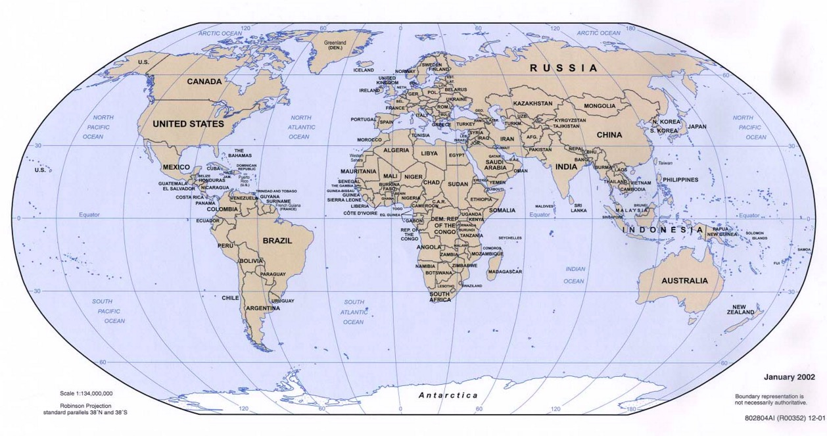
Countries (Input)
10 Countries
2013 National Power Index (NPI)
Health, Education, Wealth, Democracy, Peace, Environment

Slide 4

Infection Rate (Input)
Infection Rate: an estimation of the rate of progress of a disease
Rates measure the probability of an infection occurring in a given population

Slide 5

Time (Input)
Measured in # of Days

Slide 6
Data Used
Country Populations
Infection Rates
Rates of Travel
International: ~6.572 million travelers / 7.125 billion people on earth = 0.00092280701
U.S.A.: ~1.73 million travelers / 316.5 million people = 0.00547295159
Rate of Interactions
# of human contacts per day
Combined to create mathematical equation used to represent the spread of infection

Slide 7
Simulation of the Spread of Infectious Diseases
Output
Order of Countries Infected
Number of Infected People per country
% of Population infected
Number of Uninfected People per country
% of Population Uninfected
Distance Traveled
Location where outbreak ended

Slide 8
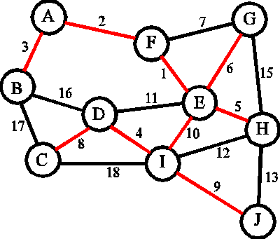
Minimum Spanning Tree
Objective: create a tree that minimizes the total weight and contains ALL vertices
Often used to construct network to minimize total amount of wire / cable used
Given an undirected weighted graph ==> Prim’s Algorithm will produce a Minimum Spanning Tree (MST)

Slide 9
Prim’s Algorithm
“Greedy” Algorithm: problem solving technique that makes locally optimal choices at each stage
Basic Idea:
“…begin with some vertex s, defining the initial ‘cloud’ of vertices C. Then, in each iteration, we choose a minimum-weight edge e = (u,v), connecting a vertex u in the cloud C to a vertex v outside of C. The vertex v is then brought into the cloud C and the process is repeated until a spanning tree is formed” (Goodrich, 664)

Slide 10
Prim’s Algorithm
Vertices == airports
Weight == distance (calculated based on longitude & latitude)
Order of vertices == Progression of Disease
Establish a connection between each vertex to simulate the ability to travel from any airport to another
Every vertex has degree of 9
V Vertices
(V-1)² Edges

Slide 11

Prim’s Algorithm
Vertices: V
Edges: (V–1)²
Efficiency: O(V²)

Slide 12
Prim’s Algorithm
Two Arrays & Adjacency Matrix
Array #1: Holds All Vertices
Array Index corresponds with Adjacency Matrix Column or Row
Array #2: Holds Array Index’s that are currently in MST

Slide 13

Adjacency Matrix
United States of America: Atlanta (ATL)
China: Beijing (PEK)
India: New Delhi (DEL)
Japan: Tokyo (HND)
Germany: Frankfurt (FRA)
United Kingdom: London (LHR)
France: Paris (CDG)
Russia: Moscow (DME)
Brazil: Sāo Paulo (GRU)
Italy: Rome (FCO)

Slide 14
Adjacency Matrix
0 | 1 | 2 | 3 | 4 | 5 | 6 | 7 | 8 | 9 | 10
1 | 0 | 7171 | 7972 | 6866 | 4606 | 4201 | 4384 | 5408 | 4667 | 5024
2 | 7171 | 0 | 2368 | 1299 | 4832 | 5067 | 5089 | 3595 | 10924 | 5063
3 | 7972 | 2368 | 0 | 3642 | 3798 | 4182 | 4080 | 2677 | 8948 | 3687
4 | 6866 | 1299 | 3642 | 0 | 5809 | 5960 | 6032 | 4660 | 11520 | 6147
5 | 4606 | 4832 | 3798 | 5809 | 0 | 410 | 285 | 1264 | 6096 | 599
6 | 4201 | 5067 | 4182 | 5960 | 410 | 0 | 216 | 1581 | 5879 | 897
7 | 4384 | 5089 | 4080 | 6032 | 285 | 216 | 0 | 1542 | 5844 | 684
8 | 5408 | 3595 | 2677 | 4660 | 1264 | 1581 | 1542 | 0 | 7326 | 1488
9 | 4667 | 10924 | 8948 | 11520 | 6096 | 5879 | 5844 | 7326 | 0 | 5861
10 | 5024 | 5063 | 3687 | 6147 | 599 | 897 | 684 | 1488 | 5861 | 0

Slide 15
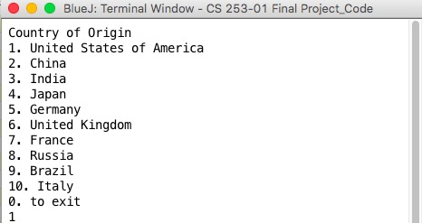
Final Project Simulation
Enter the Origin of the Infectious Disease

Slide 16
Final Project Simulation
Enter the Infection Rate

Slide 17

The Future
Will be updated to include:
More Countries
More Accurate Data

